Slide 1
EMPLOYEE ATTRITION ANALYSIS
By Vanshika Rawat

Slide 2
Objectives
Identify Key Attrition Drivers
Quantify Attrition Trends
Predict Future Attrition
Evaluate Impact on Business
Recommend Retention Strategies
30/03/24

Slide 3
Data Collection
The Data has been collected in the form of a xls file named “attrition.xls”.
The xls file has the data (Market capital and Quarterly Sales) of top 500 companies.
30/03/24

Slide 4
Data Cleaning
Identify and deal with missing data appropriately.
Check for and eliminate duplicate records. Removed the unwanted columns employee_count, over_18, standard_hours.
Standardised the data formats.
30/03/24

Slide 5
Data Analysis
Statistical Methods
Statistical methods such as regression analysis, t-tests, and chi-square tests are used to identify significant factors contributing to employee attrition.
These methods help determine the relationships between various variables and the likelihood of attrition.
Data Visualization
Data visualization techniques such as bar charts, pie charts, and scatter plots are used to visually represent the patterns and trends in the data.
These visualizations provide a clear understanding of the attrition rates and the factors influencing attrition.
30/03/24

Slide 6
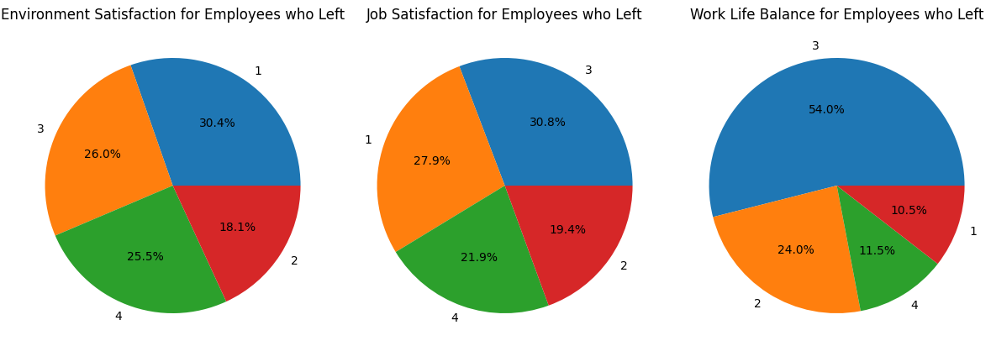
Data Analysis
Attrition of different Employee’s
30/03/24

Slide 7
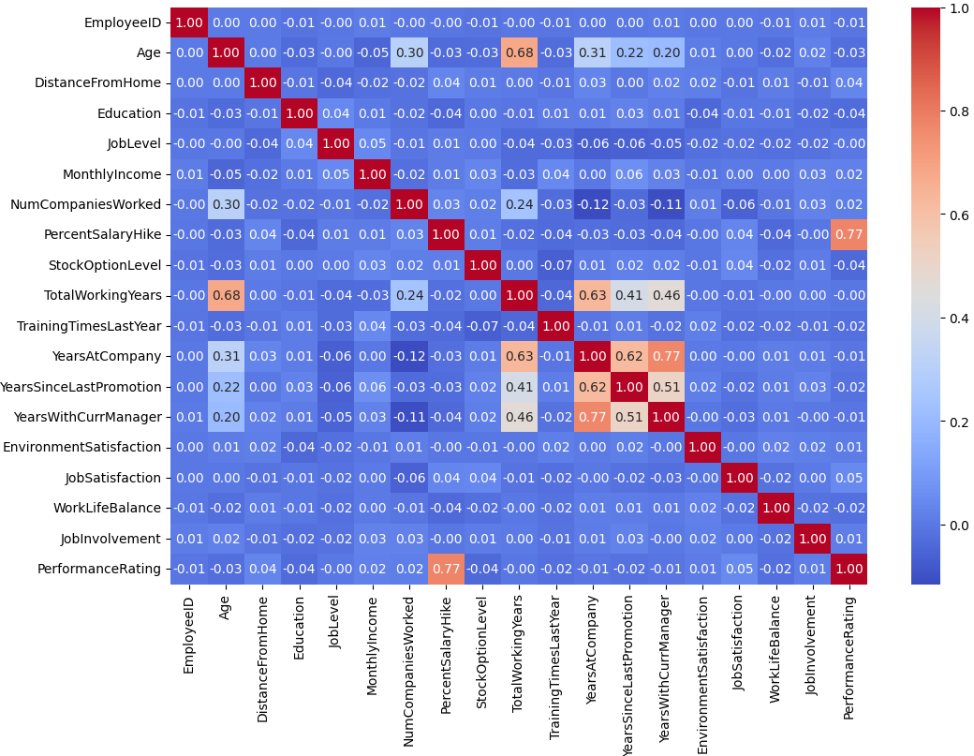
Data Analysis
Correlation Matrix of Numerical Features
30/03/24

Slide 8
Recommendations
Improve Onboarding Process
Enhance the onboarding experience to ensure new employees feel valued and supported from day one.
Provide clear expectations, training, and resources to help new hires succeed.
Career Development Opportunities
Implement a career development program to help employees grow and advance within the company.
Offer training, mentorship, and opportunities for skill development.
Competitive Compensation and Benefits
Conduct a comprehensive review of compensation and benefits packages to ensure they are competitive in the market.
Consider offering additional perks and incentives to attract and retain top talent.
30/03/24

Slide 9
THANK YOU

